Slide 1

WAY TO ENTERPRISE
Java Basics
VTI ACADEMY
Author: duy.nguyenngoc1@vti.com.vn
March 2020

Slide 2
Agenda
Internationalization
Annotations
Inner class
Garbage Collector
Java structure
Interview
Assignments
Copyright © VTI Academy All Rights Reserved

Slide 3
Internationalization
I18N
Support language & format number, money, … base on Locale
NumberFormat
DateFormat

Slide 4
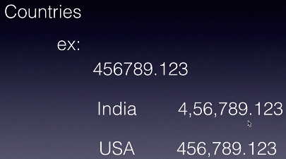
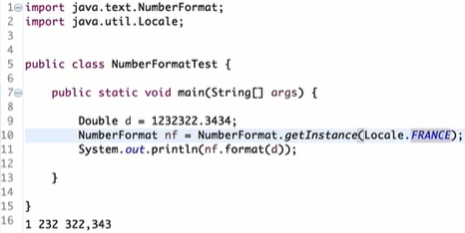
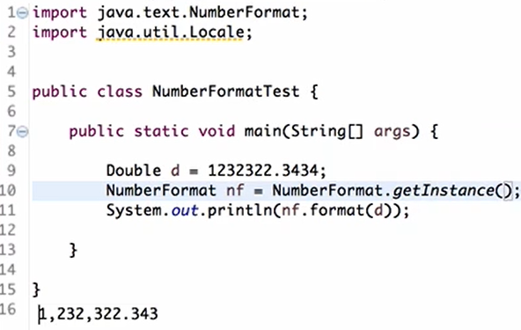
NumberFormat

Slide 5
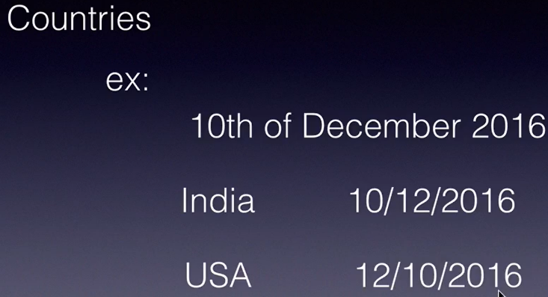
DateFormat
DateFormat
SimpleDateFormat

Slide 6
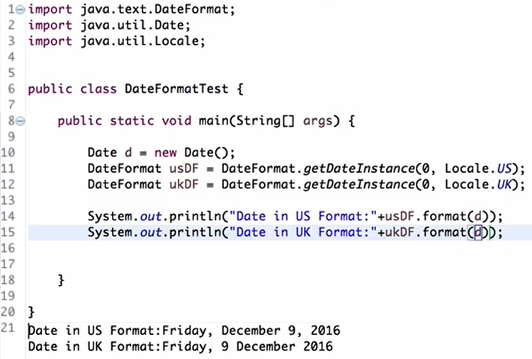
DateFormat

Slide 7
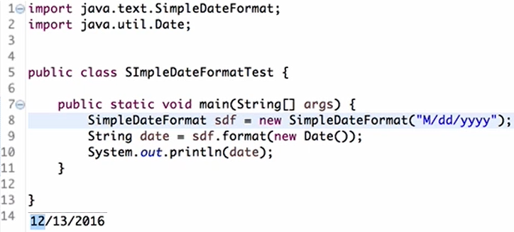
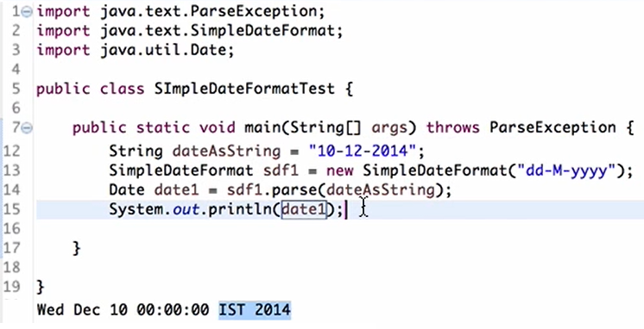
SimpleDateFormat
Convert Date → String
Convert String → Date

Slide 8
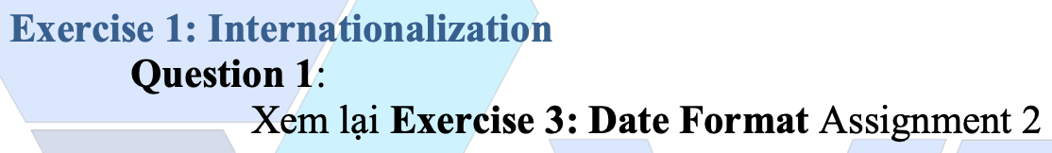
Testing System Assignments
Exercise 1: Internationalization

Slide 9
Annotations
@Override
@Deprecated
@SuppressWarnings

Slide 10
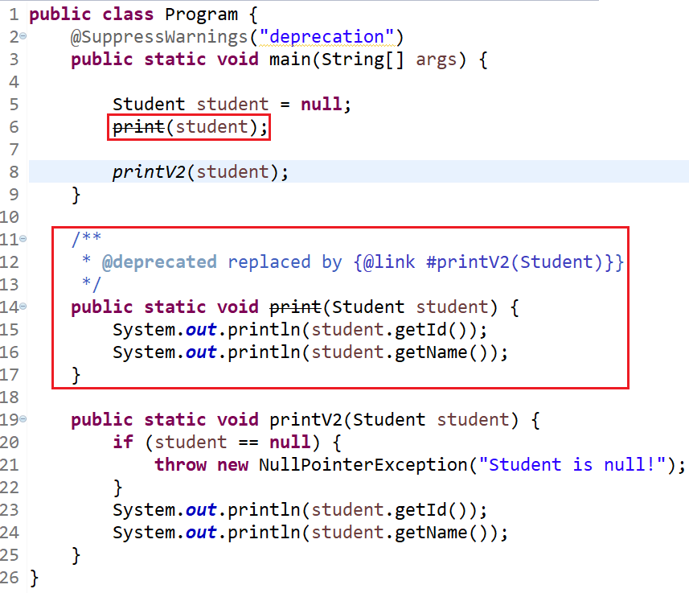
@Deprecated

Slide 11
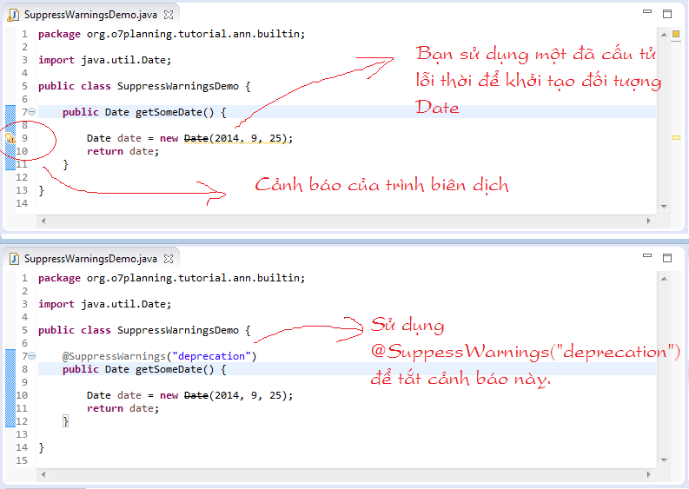
@SuppressWarnings

Slide 12
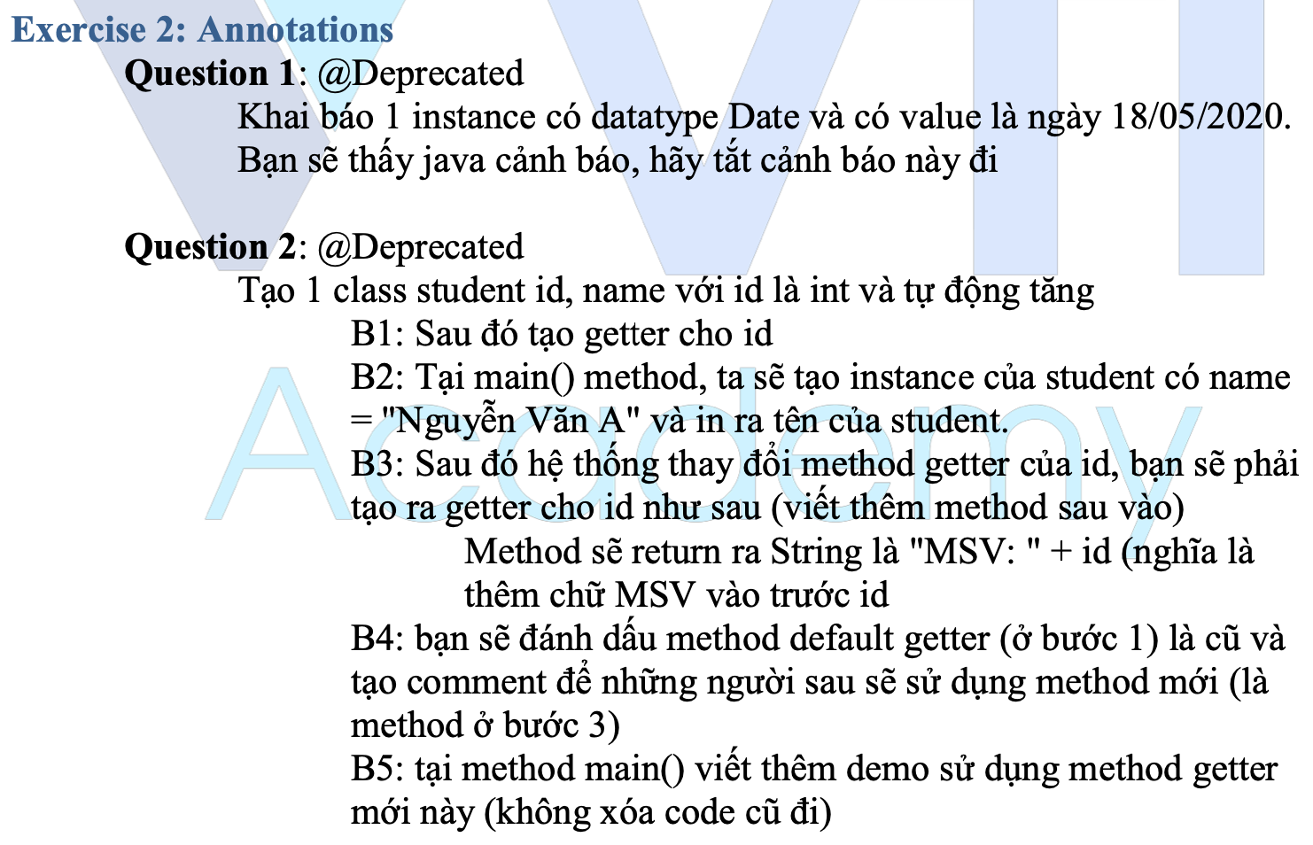
Testing System Assignments
Exercise 2: Annotations

Slide 13
Inner class
Static & non-static, final, access modifier, inheritance, polymorphism, … similar to Class
Type
Object
Method
Notes:
Khi nào dùng: khi chỉ có class đó sử dụng inner class ➔ tăng tính encapsulation

Slide 14
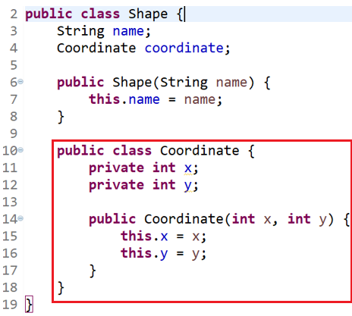
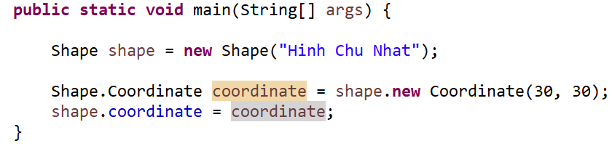
Inner class (Object)

Slide 15
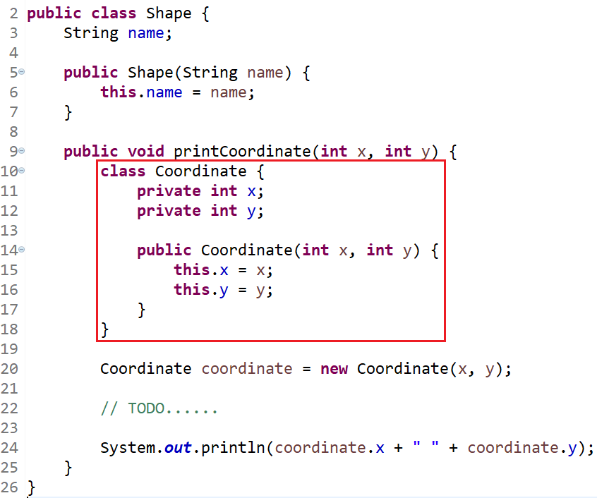
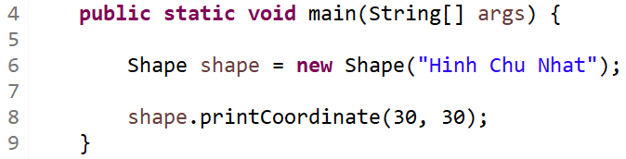
Inner class (Method)

Slide 16
Testing System Assignments
Exercise 3: Inner class

Slide 17
Garbage Collector
Collect "Garbage"
Garbage is
Object has null pointer
Parent of object has null pointer
Local variable

Slide 18
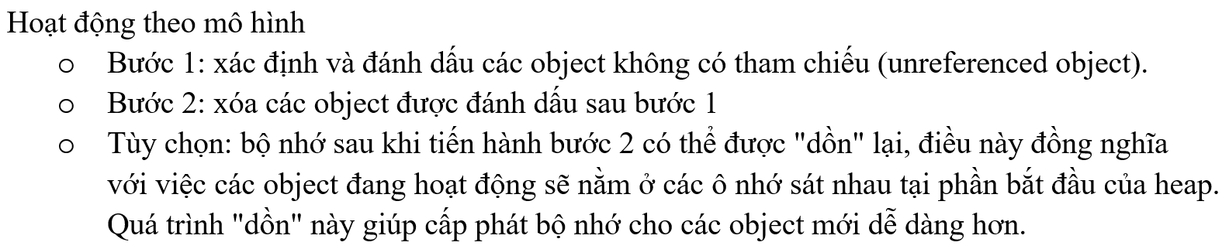
Garbage Collector

Slide 19
Garbage Collector
Methods
System.gc()
finalize()

Slide 20
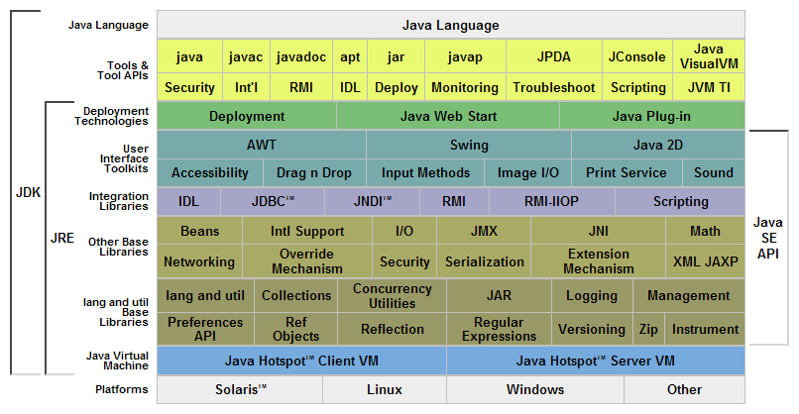
Java Structure

Slide 21
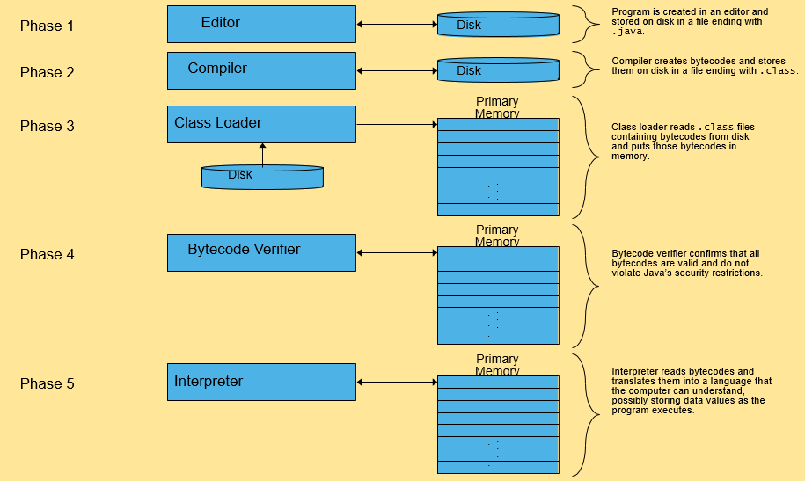
JVM

Slide 22
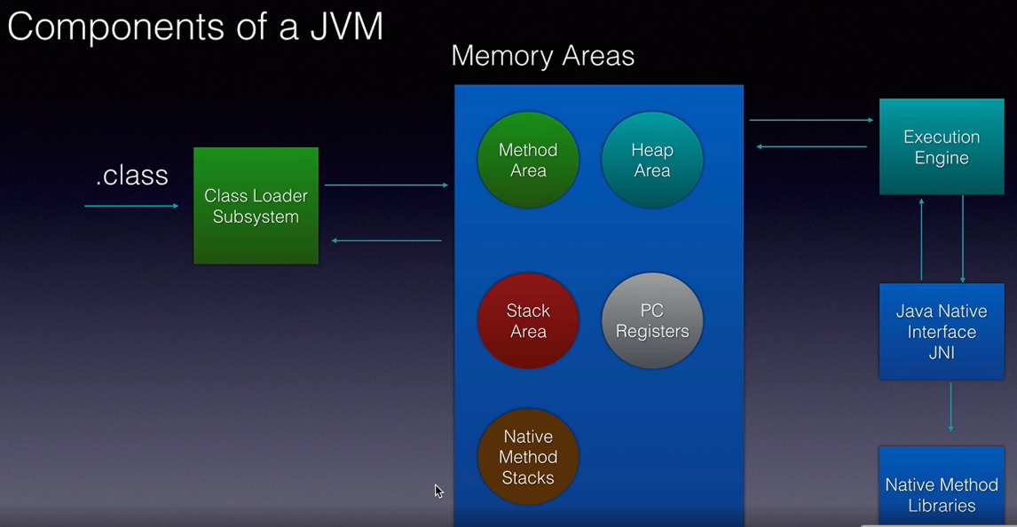
Memory

Slide 23
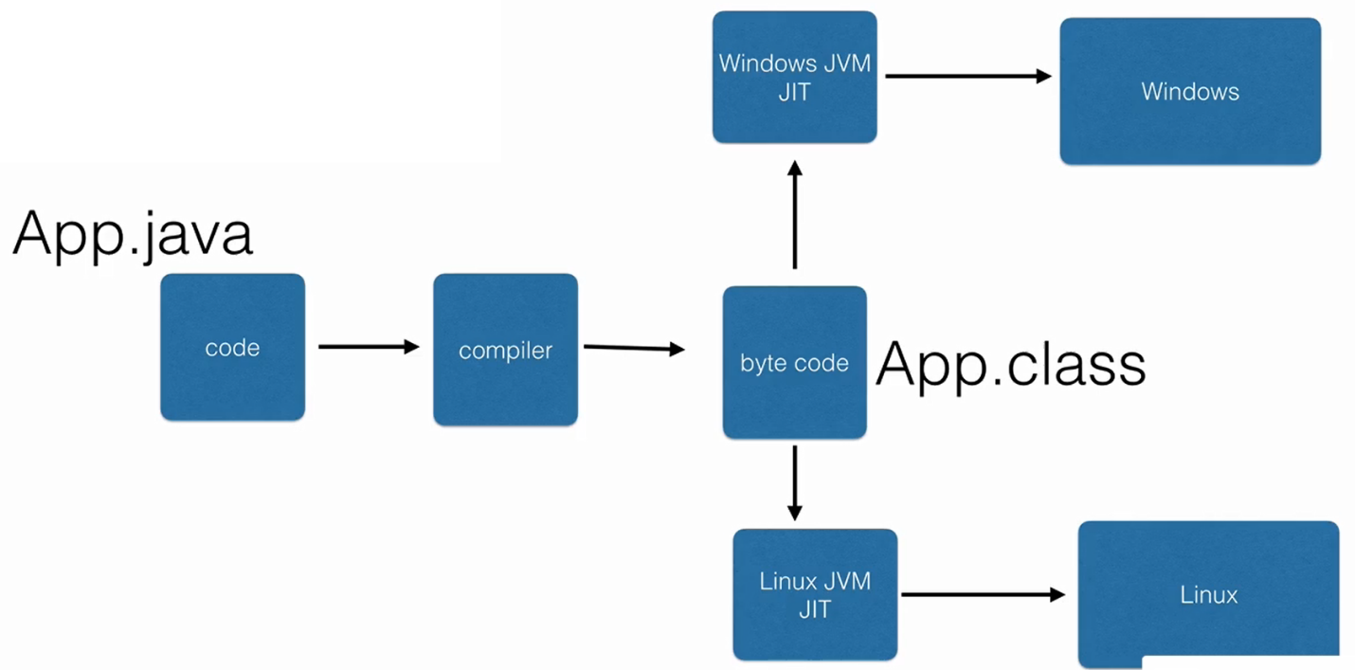
Interpretion & Compilation
Interpretion (Thông dịch)
Compilation (Biên dịch)

Slide 24
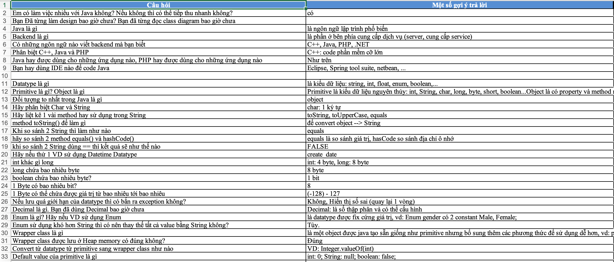
Interview
https://docs.google.com/spreadsheets/d/1KdhxJmJGWlec3r81gBvN862uDzvak0d4?rtpof=true

Slide 25
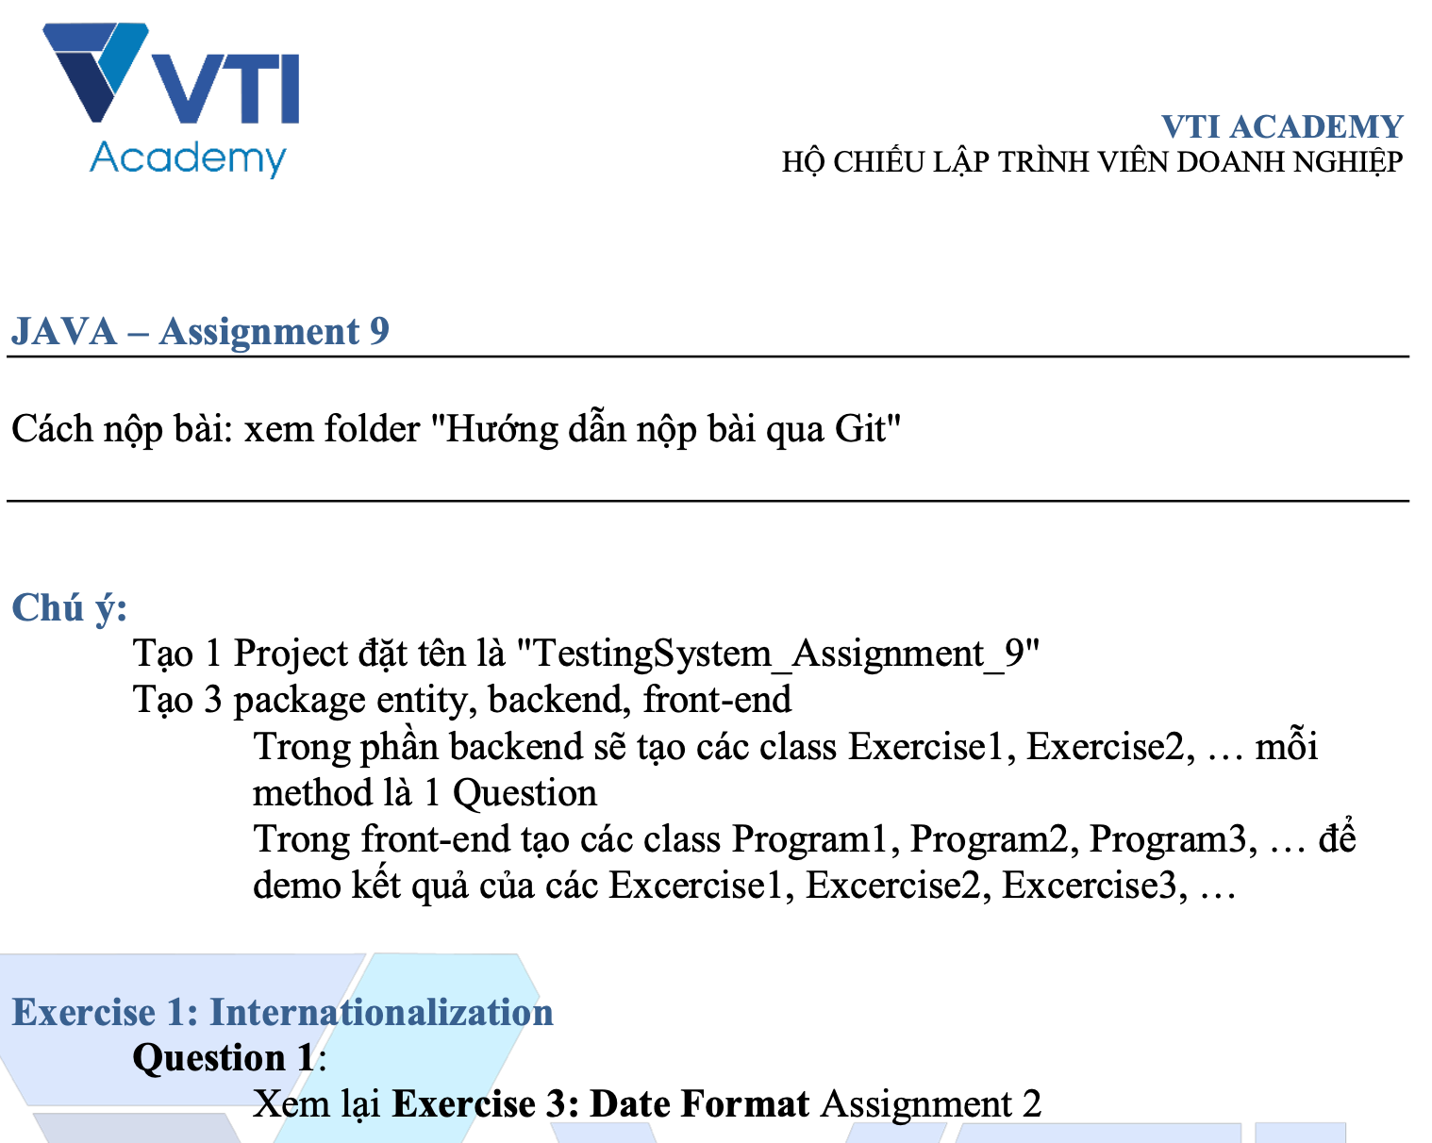
Testing System Assignments

Slide 26
Q & A
Copyright © VTI Academy All Rights Reserved

